Slide 1
Church of the Incarnation RE-entry Planning Committee Strategic Action Plan
In Sacred Safety
Reverend Roberta Knowles, RECTOR+

Slide 3
Our mission:
“On Being Faithful Provides each of our congregation, schools, and special ministries clear guidance and direction for how we in the diocese may begin to move forward as a witness to forming of new habits and practices by which to live courageously and faithfully into the new season that is now unfolding before us”
Excerpt from on Being faithful guidelines for a shared discernment on the way ahead in this season Of covid-19 South florida diocese, bishop peter eaton++

Slide 4
Staying on track Our coi-crpc task & purpose
The Church of the Incarnation Church Re-entry Planning Committee Purpose:
Our Task: When the time is right (health conditions being mitigated according to health officials) and we have the plan of action, training, essential equipment and supplies -we will have a *document to request that we re-enter our beloved Church of the Incarnation. This document will be reviewed by the parish council, vestry, rector, deanery and prayerfully approved by the bishop’s office.
We seek to use a PowerPoint and a Checklist Approach to Educate, Inform and Train.
Generate a Request Letter to the Bishop to re-open with attached checklists, schedules, evidence of completed training, information, procedures and protocols.

Slide 5
Our timeline
March 2020
Physically Close the church.
Implement Season I guidelines.
Initiate Online Live stream Church Service
March 29, 2020
April 2020
Continue Season I guidelines.
Maintain online Live stream Church Service
Implement Conference Call
Maintain Bible Study online

Slide 6
Our timeline
May 2020
Initiate the Church Re-entry Planning Committee
On May 19, 2020
Established in-facility social distancing standards
Vestry approves the purchase of essential PPE and EPA approved Chemical supplies and limited Signage

Slide 7
Our timeline Goals/Planning
June 2020
Complete the requirements and documents requested by the Bishop of the Diocese of South Florida
Communicate and provide surveys to our Parishioners to gather valuable input
Schedule training and informational sessions in July
July 2020
July 6 – COI-CRPC held an All Parishioners Informational Conference Call
July 28th – COI-CRPC held a Parish Council Informational Conference Call

Slide 8
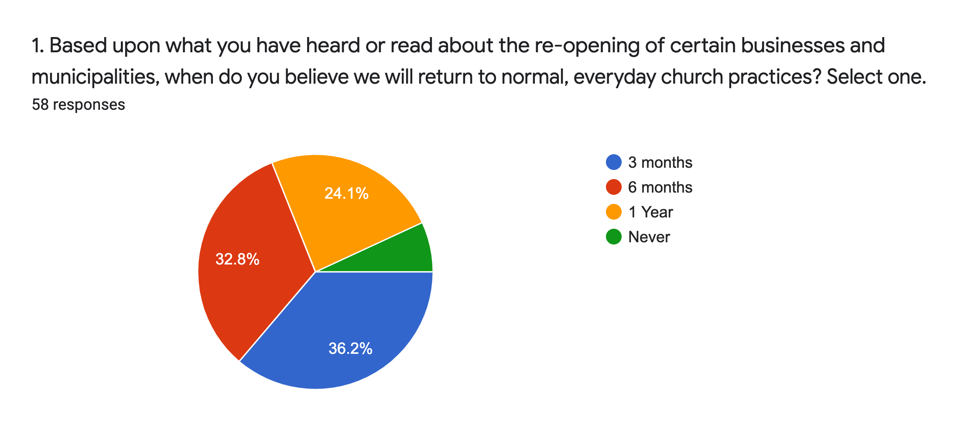

Slide 9
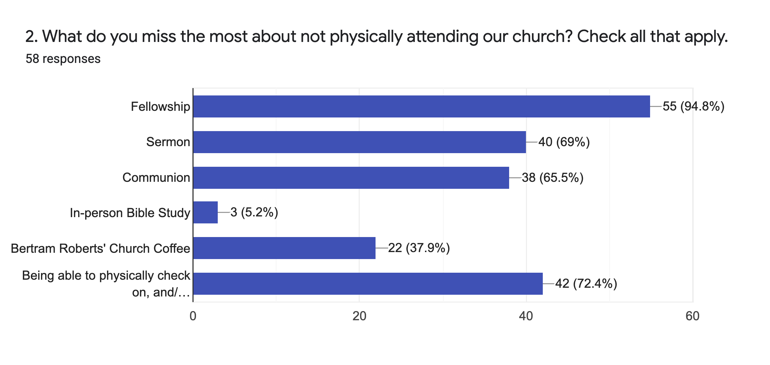

Slide 10
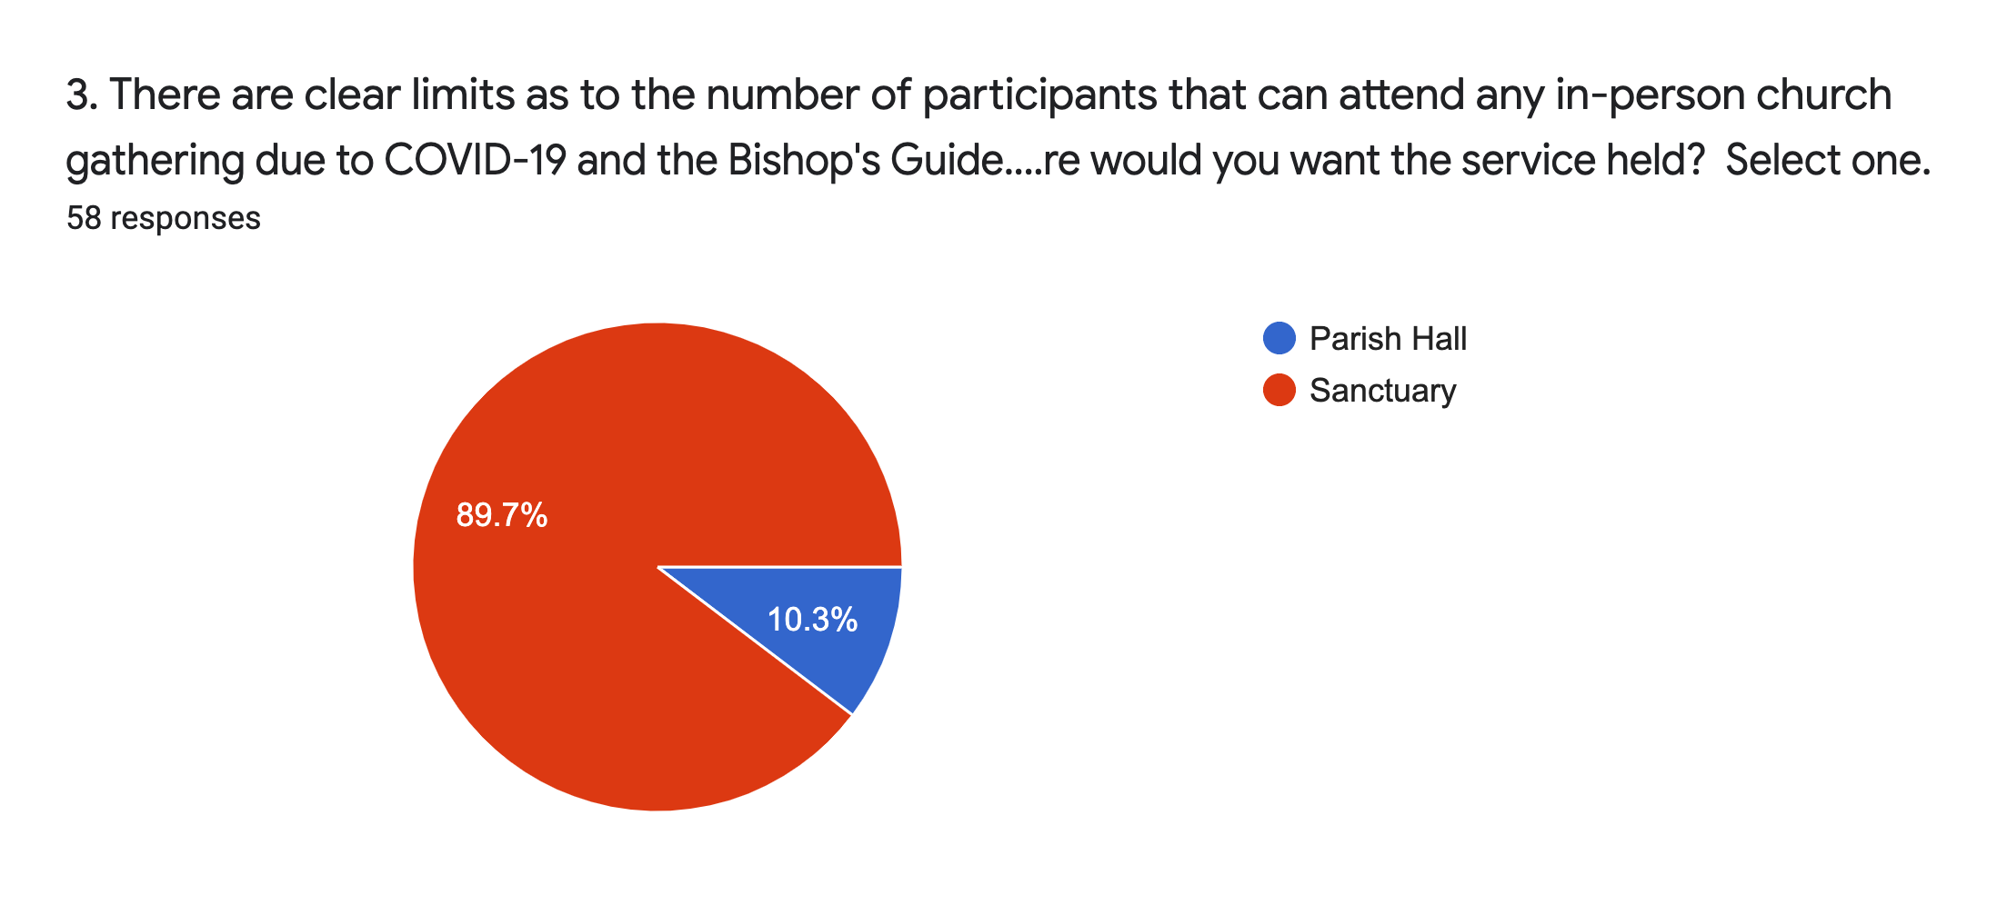

Slide 11
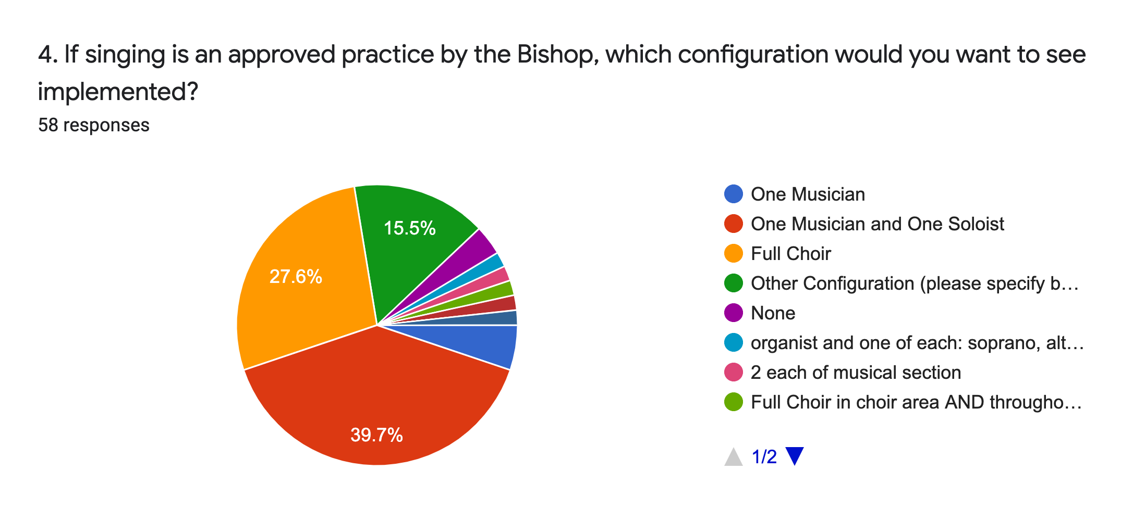

Slide 12
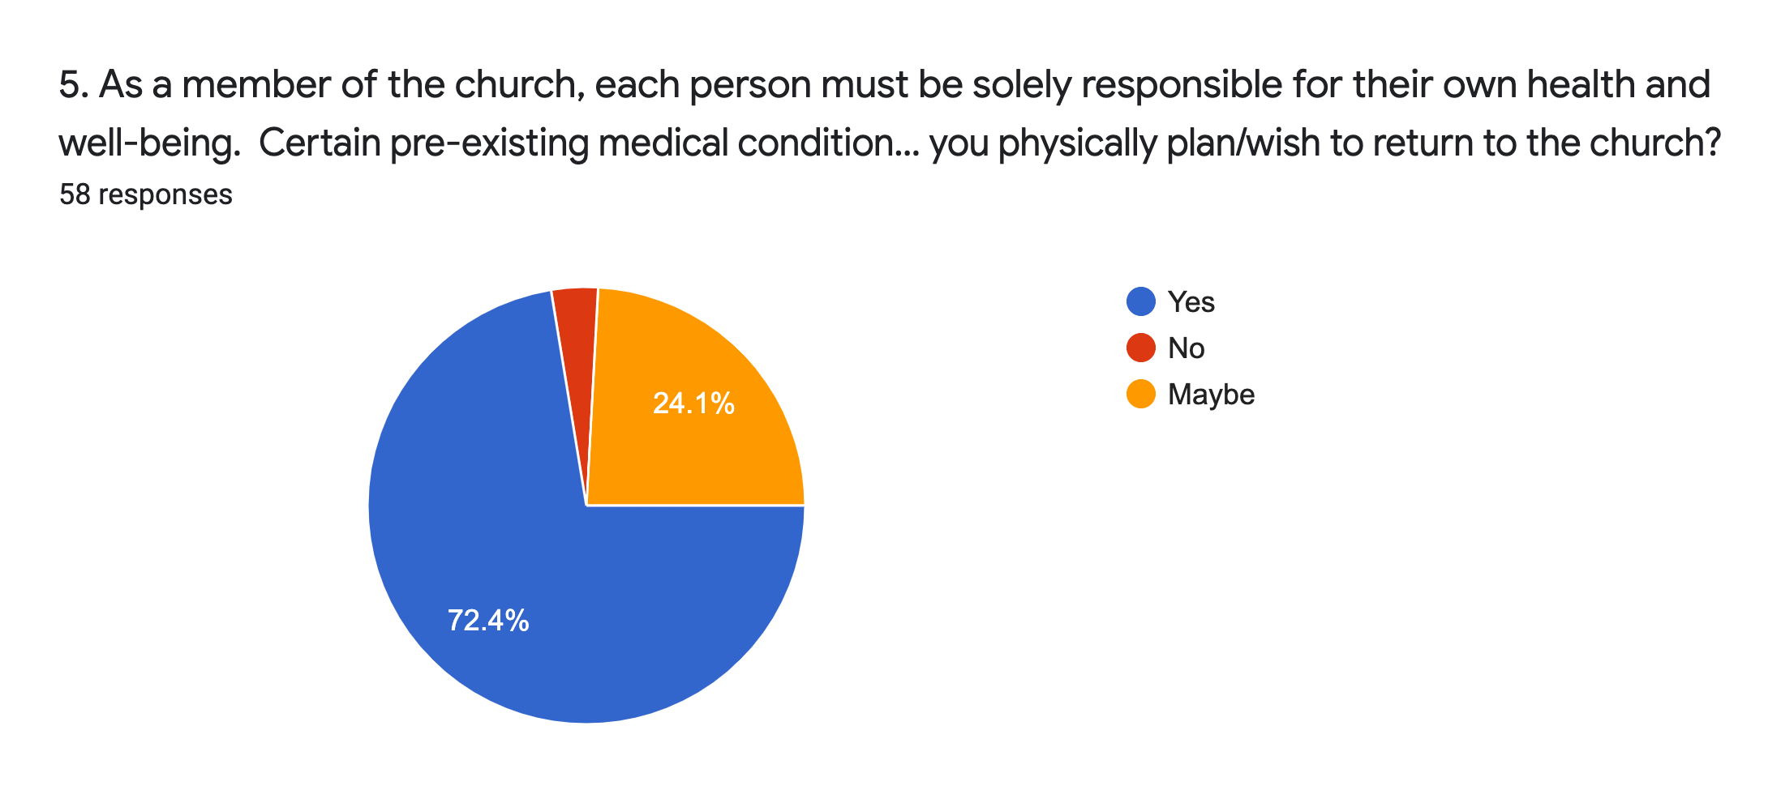

Slide 13
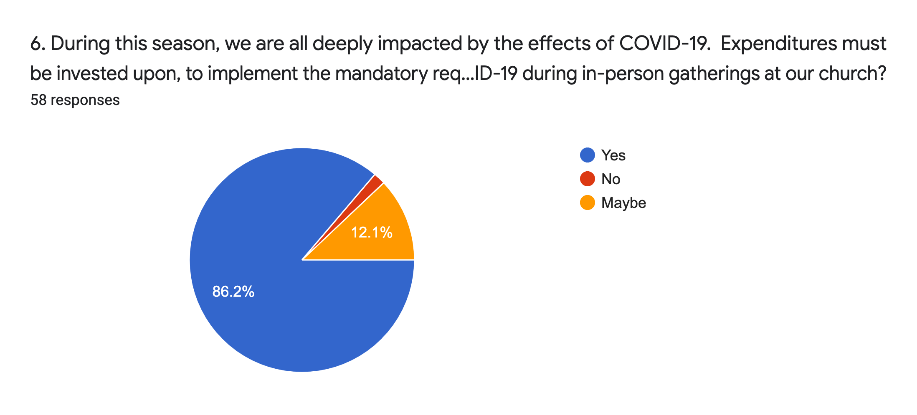

Slide 14
The Church of the Incarnation Action Plan Summary

Slide 15
Special church reopening Strategic planning workshop
Reopening Overview Powerpoint-DONE Easy to fill in survey to create your opening plan-DONE Sample letter to congregation-DONE Sample survey for congregation-DONE Sample sign package-DONE, Budget
Special Church Reopening Strategic Planning Workshop
It is the wisdom of the clever to understand where they go, but the folly of fools misleads.- Proverbs 14:8

Slide 16
August informational sessions
Our five-point plan will be monitored/maintained/updated primarily by the Rector, Sr. Warden, Vestry, Health teams, Greeters/Ushers of the Church of the Incarnation and the Church re-entry planning committee (COI-CRPC)
We are advised to keep our group small and adhere to social distancing guidelines/CDC recommendations. Our church can accommodate and encourage smaller groups to attend bible study and small informational sessions on COVID-19 prior to Sunday gatherings.
The FIVE–POINT Plan
“FIVE SAVES LIVES!”
A Checklist and Powerpoint Approach

Slide 17
Comfort our membership and guests. Our church is committed to engage in Sacred Safety practices.
Inform and encourage our members to embrace the mandatory changes that will be implemented.
We will wear masks, conduct temperature checks, maintain social distancing, perform contact tracing, collect waivers, hand wash and use hand sanitizer.
Request that all members agree to leave the premises as soon as the service is over.
Usher-directed, we will use the designated doorways to discourage social gathering.
Expect that our members will adhere to the signage and CDC-approved directions provided.
We will follow guidelines on where and how to enter the parking areas/premises/worship areas/restrooms.
Faithfully and safely keep our members informed and mobilized.
We will continue to chart a path to grow, enhance and fund our Church’s mission: Evangelism.
Decisions by the Rector, Vestry and COI-CRPC will be based upon the health and safety of our parishioners as the first priority. This five-point plan will be monitored/maintained by the Church of the Incarnation–Church Re-entry Planning Committee (COI-CRPC) Vestry and Rector.
The FIVE–POINT Plan
“FIVE SAVES LIVES!”
The Rector, Vestry and Church of the Incarnation, Church Re-entry Planning Committee will implement Five Saves Lives! (Our Five Point Plan) to:

Slide 18
August Informational Session SCHEDULE
Effective Immediately, we seek to use a PowerPoint and a Checklist Approach to Educate, Inform, and Train our membership on the procedures and protocols to mitigate the spread of COVID-19.
Clergy (Acolytes training will be introduced at a later date)
Ushers/Greeters
Health Teams
Sanitation Volunteer Teams
Altar Guild
Office Staff
Countroom
Music Ministry (Postponed)
Parishioners-General overview of the latest information regarding COVID-19, entry and exit requirements, wearing masks, hand sanitation, contact tracing, temperature checks, social-distancing seating, sample service bulletin, offertory procedures, restroom protocols, office use, self-reporting procedures, communications, mental health, racial disparities, guilds and groups, bible-study. Together we will move forward with courageous, faithful, and innovative ways to grow, enhance and fund our church’s mission: Evangelism.

Slide 19
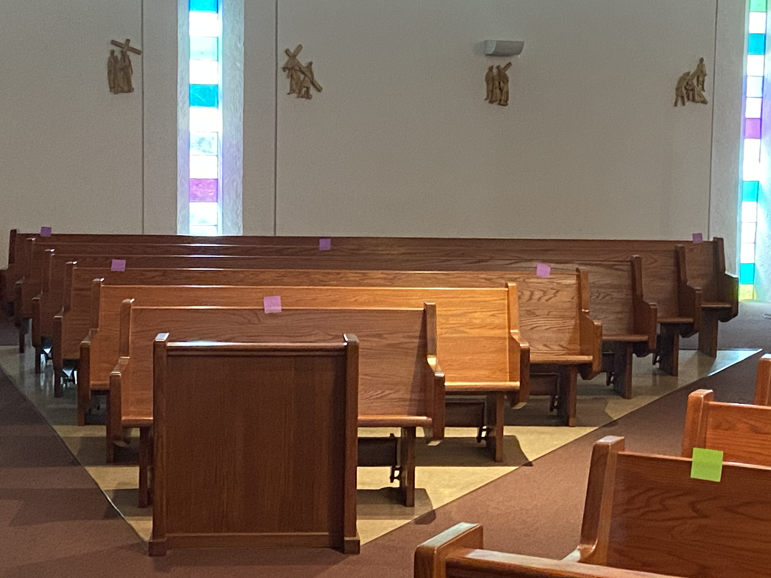
Social distancing

Slide 20
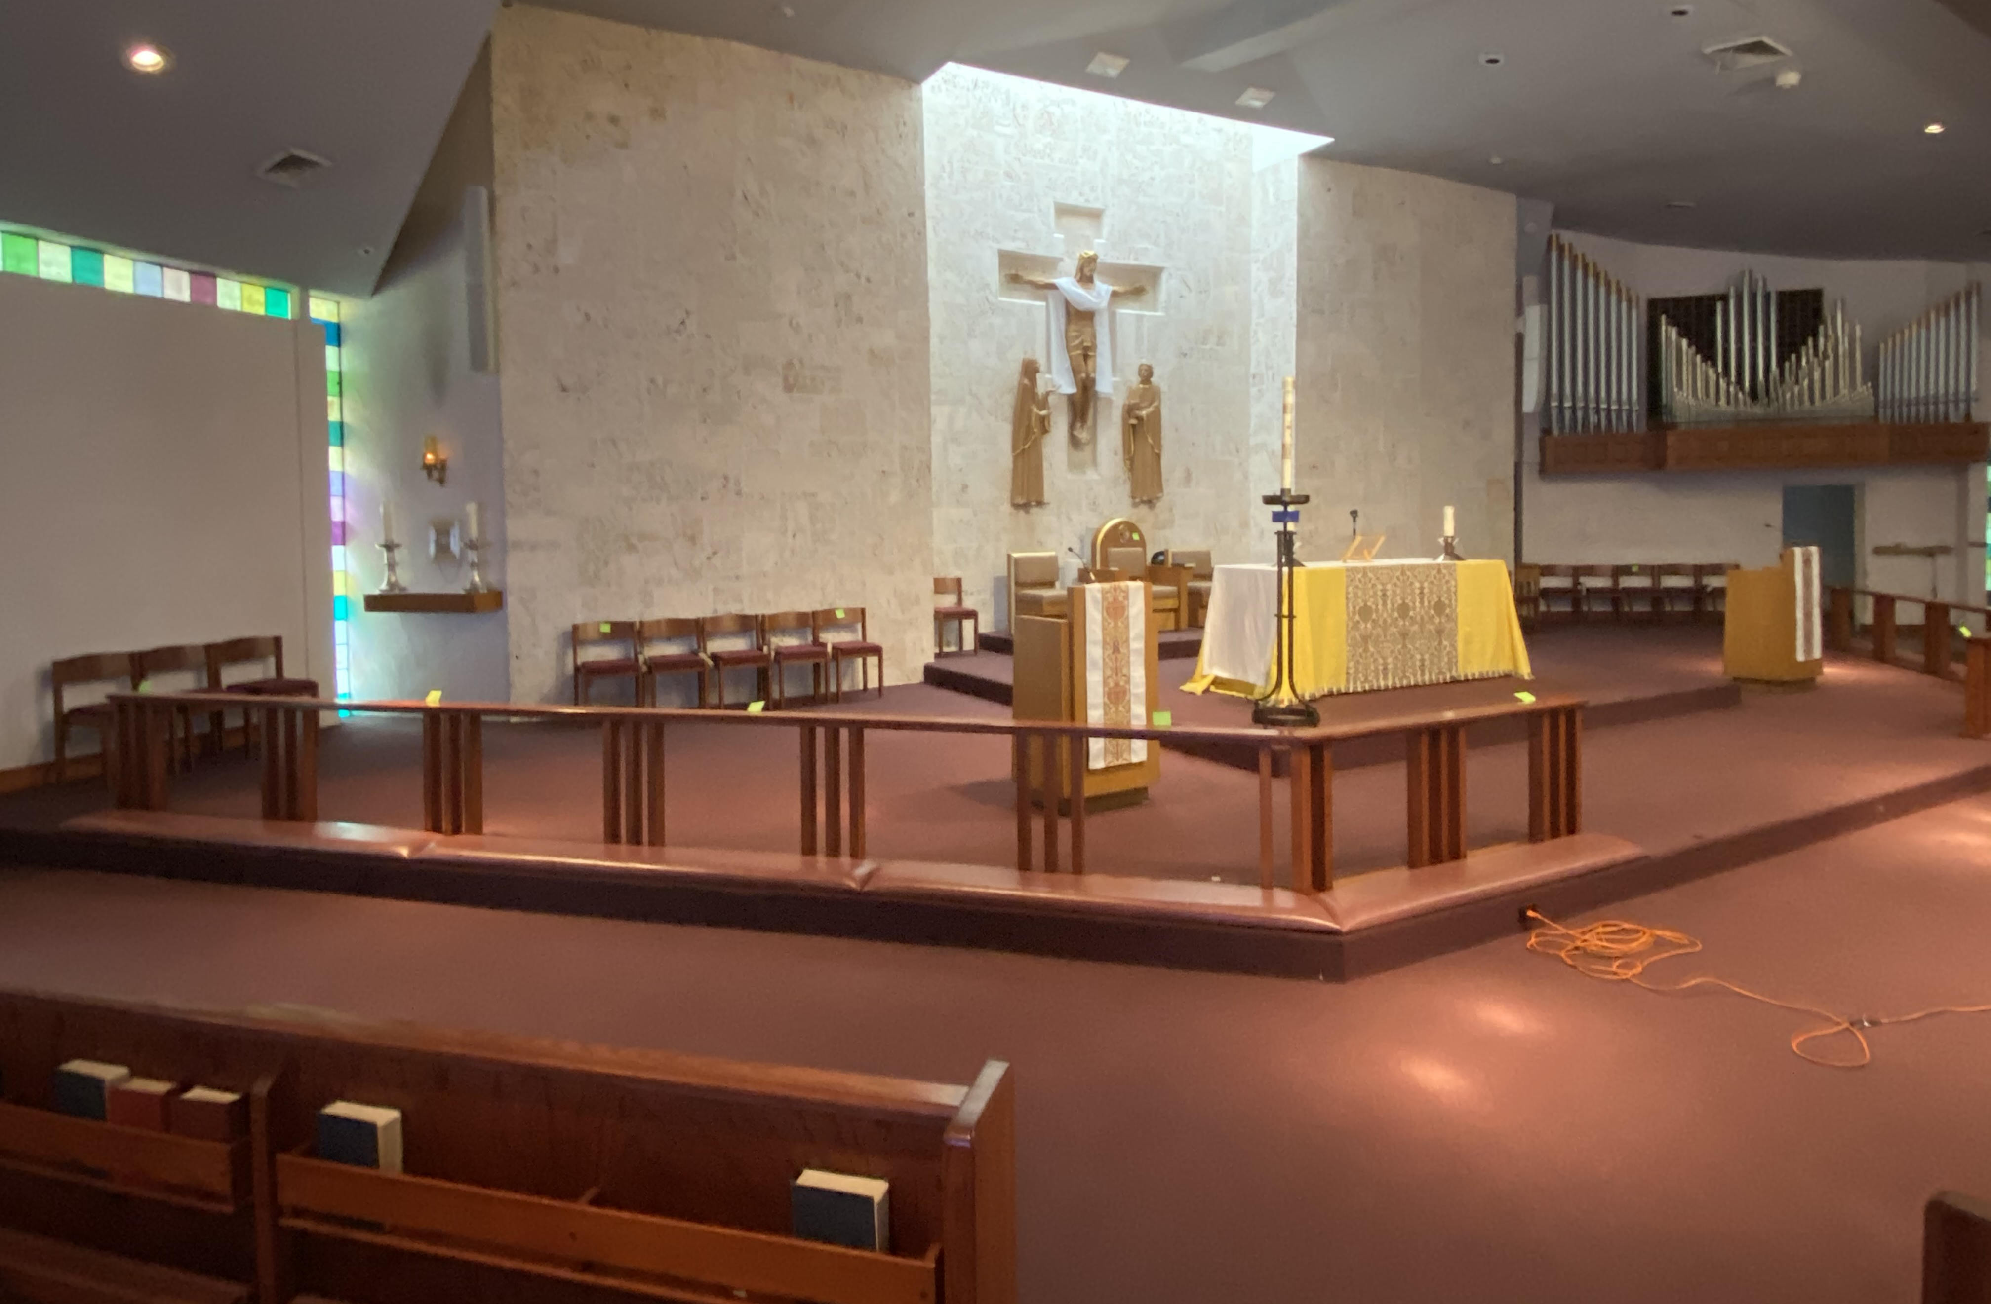
Social distancing

Slide 21
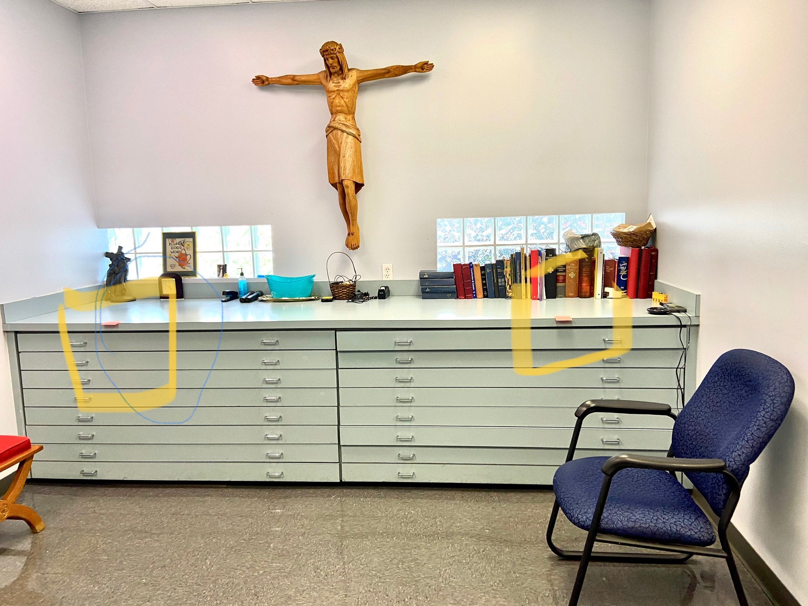
Social distancing

Slide 22
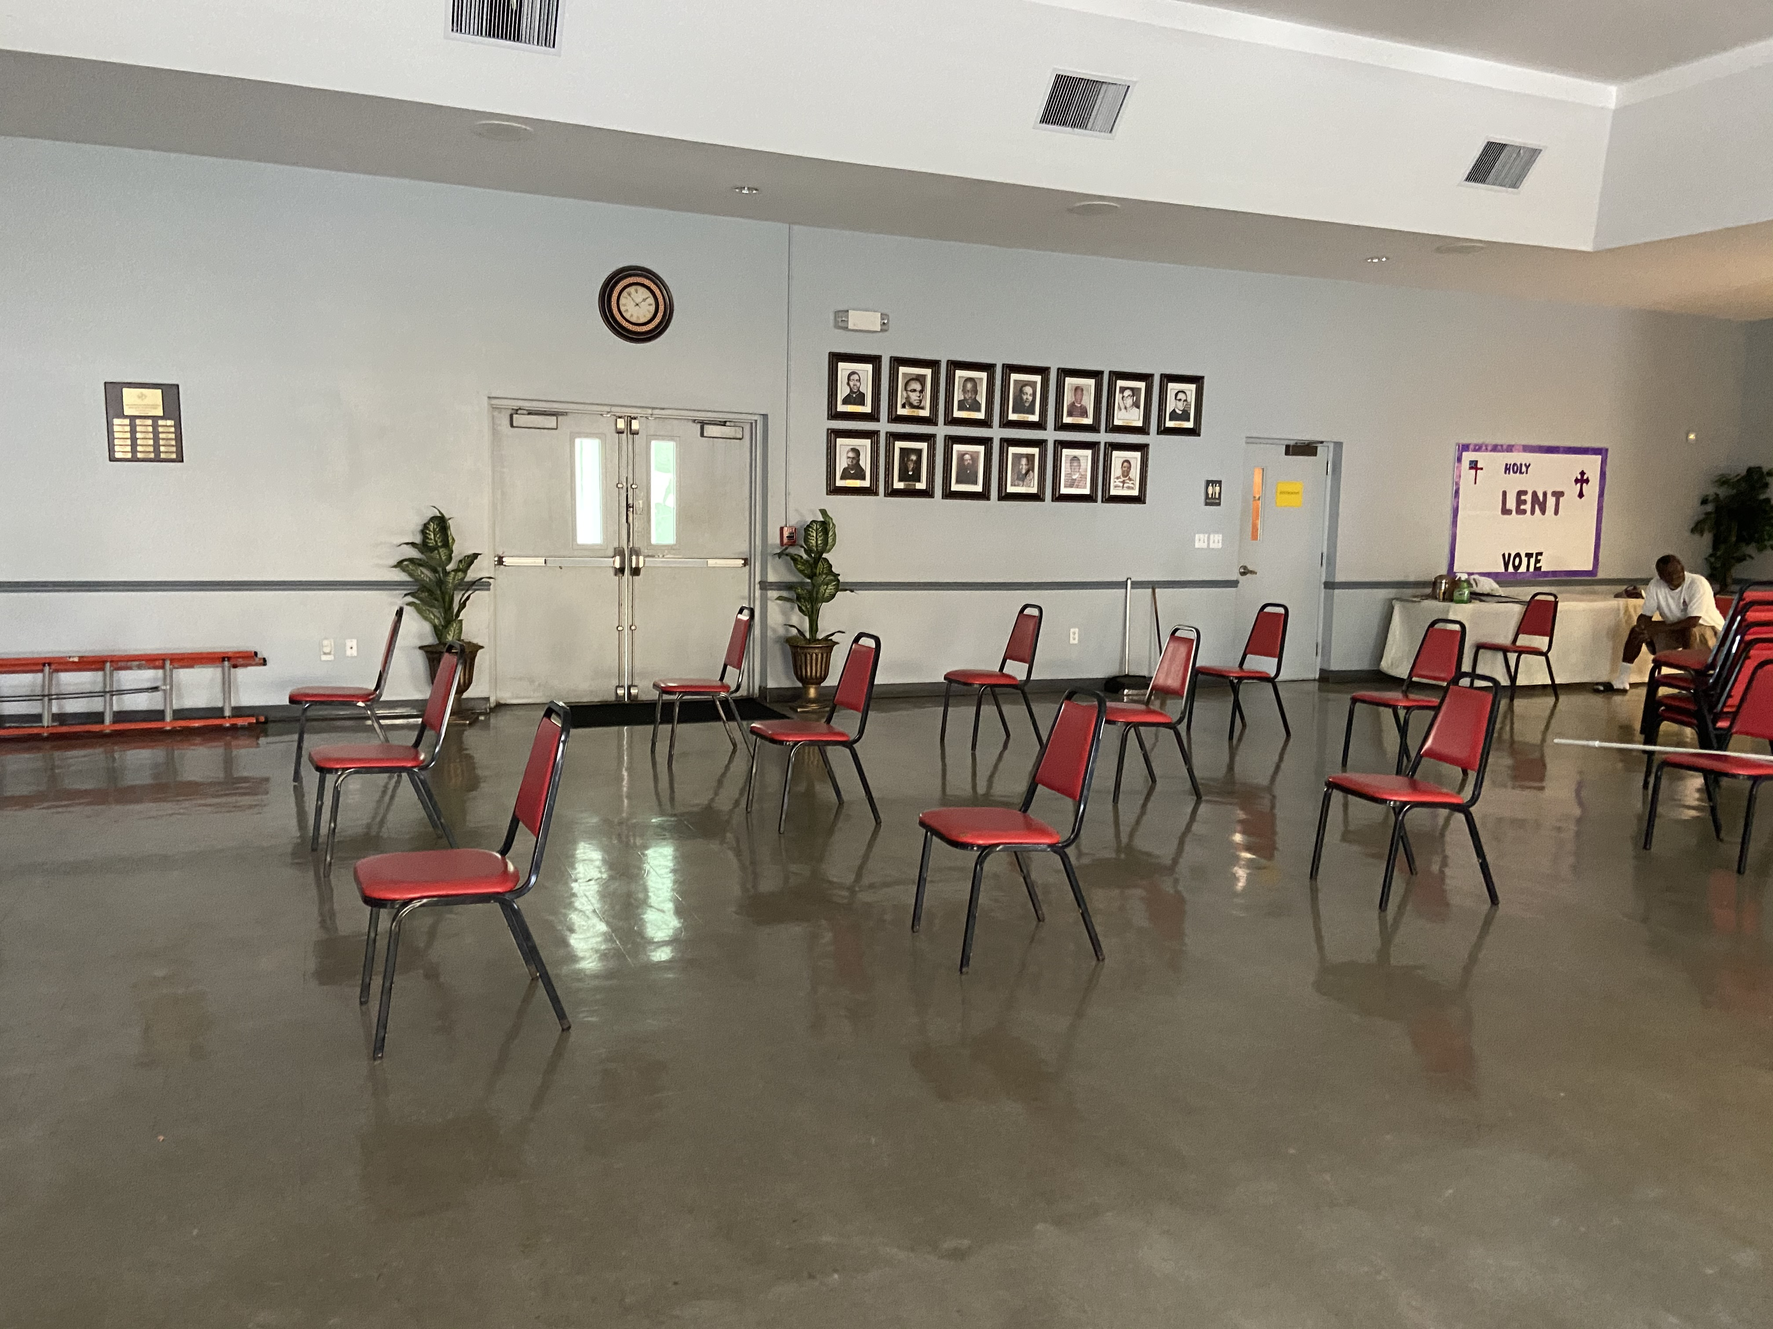
Social distancing

Slide 23
NEXT STEPS…
The next steps are:
Conducting a walkthrough using the Sanctuary
Finalize the Service Bulletin with mitigation protocols in place.
Creating the PowerPoints to match the Checklists of protocols -for training and information purposes.
Schedule the Informational sessions with church groups and parishioners.
Setting a re-opening date. TBA
Utilize an RSVP call center for members to indicate their attendance.
Schedule additional small group services prior to the “Easter” Re-entry of our Church.
Be prepared to re-enter the Church of the Incarnation, as approved by the Bishop’s Office and as advised by Health officials of the appropriate community conditions.
We Can DO It!

Slide 24
September 2020
Any outbreak or State and local changes can delay any of these plans, but we will continue to prepare.
Sincere thanks to all of our Parishioners, Vestry, COI-CRPC and Reverend Roberta Bobbie Knowles for their on-going prayers, support and expertise.
For Sacred Safety,
Agenoria Powell, COI-CRPC Chair

