Slide 1
Church of the COVID 19 Reopening Health Team Training Session
Cynthia Anderson, RN,ADN
Reverend James Bell, RN,MSN
Mildred Byrd, RN,BSN

Slide 2
Brief Overview of Coronavirus/COVID 19
DEFINITION
SYMPTOMS
An acute respiratory syndrome (group of symptoms occurring together) caused by the newly discovered coronavirus. It’s a virus within the corona.
May appear 1-14 days after exposure
Can affect persons differently
May include: Fever greater than 99.0 F
Chills ,body aches, headache and or
persistent dry cough
Shortness breath, running nose
Sudden loss of taste or smell
Sudden confusion and inability to stay awake
Chest pain or discomfort
SEEK EMERGENCY MEDICAL CARE IMMEDIATELY
("Coronavirus disease 2019 ( COVID-19)," 2020)

Slide 3
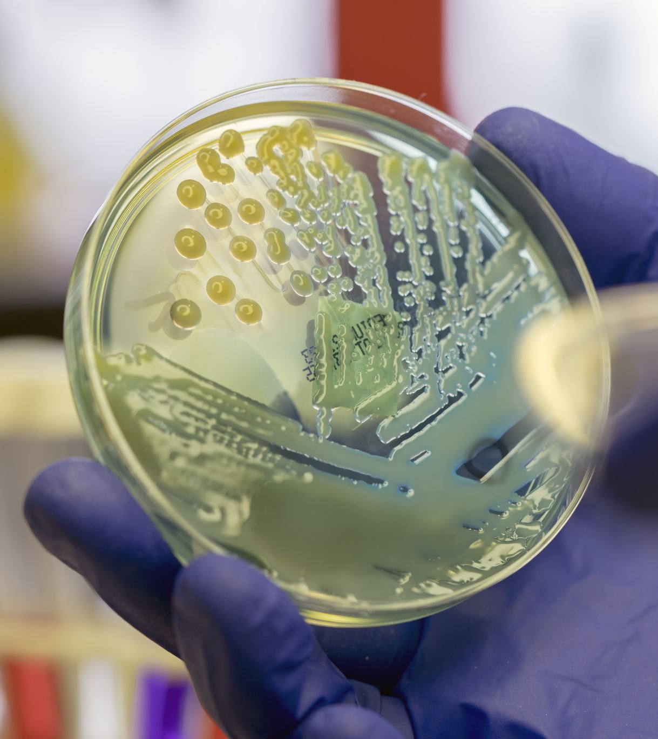
Transmission of Virus
Person to person with minimal or no symptoms.
Droplet contact: Coughing or sneezing
Entry points: Eyes, nose and mouth

Slide 4
Treatment
There is no proven treatment for coronavirus
Stay at home, notify your personal care physician
Self quarantine for 14 days
Drink plenty fluids
Monitor symptoms
Wear masks around others in the home including pets
HAND WASHING, MASKS, SOCIAL DISTANCING IS THE KEY!!

Slide 5
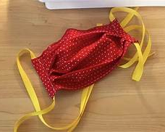
FACE COVERINGS and SOCIAL DISTANCING
All clergy, staff and members MUST wear a mask : fabric masks washed daily or hospital/surgical mask it must be changed daily. If no mask present, the church will provide one.
Limit the size of your groups.
6 feet apart in either direction: Front–back and side to side.
Cover cough or sneezing with a tissue or into elbow.
No hand shaking or hugging for now.

Slide 6
HANDWASHING: CLERGY, STAFF and MEMBERS
Wash hands 20 seconds with soap and water.
If Soap and water not available: Use hand sanitizer located in designated areas.
Make sure when using the soap or the sanitizer that your hands feel dry.
AVOID TOUCHING EYES, NOSE AND MOUTH WITH UNWASHED HANDS.
("Coronavirus disease 2019 ( COVID-19)," 2020)

Slide 7
Proper Handwashing Technique ( To assess click link below)
https://youtu.be/zCx50OYOiXk
(March 2020, n.d.)

Slide 8
Proper Placing and Removal of Mask ( To assess click link below)
(March 2020, n.d.)
https://youtu.be/vuO_iaZH8ZQ

Slide 9
Health Monitoring and Screening
Check your temperature daily: No members will be allowed to enter with a fever greater than 99-degree Fahrenheit or above.
1
Your temperature will be check before entry to the sanctuary or social hall.
2
Don’t take your temperature within 30 minutes of exercise or taking medication such as Tylenol.
3
Watch also for shortness of breath, loss of taste, and persistent wet or dry cough, sore throat and diarrhea.
4
Contact your medical provider and or go to an emergency room especially for shortness of breath.
5
("Coronavirus disease 2019 ( COVID-19)," 2020)

Slide 10
CLEANING and DISINFECTING
Daily: Tables, desks, phones, keyboards, toilets, faucets and sinks.
Dirty surfaces: Use detergent or soap and water prior to disinfecting.
Use Household disinfectant to clean area after simple washing has been done.
("Coronavirus disease 2019 ( COVID-19)," 2020)

Slide 11
Testing sites
Dade County
Drive thru
Marlins Park
South Dade Government Center
Hard Rock Stadium
Amelia Earhart Park
Miami Beach Convention Center
Walk Up Testing
1. North Miami: Holy Family Catholic Church
2. Opa-locka: Sherbondy Park
Broward County
Broward Health
Central Broward Park
Cleveland Clinic
Festival Marketplace
Mitchell Moore Park ( Walk-up)
National Guard and Memorial Health Systems
Urban League of Broward County ( Walk-up
These are only a few: Please refer to www.miamidade.org and www.broward.org
For a complete list of tests.

Slide 12
Road Map Safety Check Points
Team Rotation scheduled each Sunday ( 6 persons).
Team/members arrive 45 minutes prior to start of worship service.
Social distancing 6-feet outside/inside.
One-way entrance
Masks present
Hand sanitizing
Two stations, two-person touchless temperature ( acceptable ranges: 96.0 Fahrenheit to 99.0) taken with gloves.
Two temperatures recorders: two persons on the outside assisting the seniors/disabled will be brought to front of the line.
Entry into the worship service by an usher ONLY.
NO CHANGING OF SEATING PLEASE!!!
NO SOCIAL GATHERING!!!

Slide 13
Responsibility Steps for Greeters and Health Team Volunteers
Greeters
Health Team
Greeters must be in place 45 minutes before service start time
All greeters must wash hands, wear mask while doing their assigned duties. ( if taking temperatures, put on gloves).
ENSURE MEMBERS/ GUEST HANDS SANITIZE BEFORE TEMPERATURE TAKEN
Assist the health team in during temperature check/ recordings and a note if indicated, electronically.
Extending a warm ” welcome”, volunteers will open the entrance doors so to allow members to avoid all physical contact with door handles.
Ushers will help direct the flow of members/guests through the entrances and hallways in order to limit time spent within 6 feet of others. Same protocol for exiting church.
Offerings will be collected via the offering box located in church entrance.
Health team members must be in place 45 minutes before service start time.
Health team members must wash hands before putting on masks and gloves before taking temperatures.
ENSURE MEMBERS/ GUEST HANDS SANITIZE BEFORE TEMPERATURE TAKEN
Gather the material needed: touchless thermometers. Check/ recordings and a note if indicated, electronically.
Direct the member/guest to an usher for directions into the worship center.
Be ready to assist with any member that suddenly becomes ill and follow the emergency plan.
Be prepared to escalate some medical emergencies to emergency medical services by calling 911.
This is the how to communicate to member/ Staff with a temperature:
“Your temperature is elevated, let me refer you to Cynthia/Mildred out of abundance of caution. We ask that you NOT enter the church at this time. Please continue to participate in the live stream worship service. Consult your primary care physician, as soon as possible. Thank you”

Slide 14
Emergency Plan: (Mitigation) For COVID 19
Team on duty masks/ gloves
Remove ill person immediately to designated area( Usher’s Room for members/guests and count room for office staff).
Retake temperature and Document.
Actions as indicated by assessment.
Advise to 14-day self quarantine and notify primary care physician.
Follow-up wellness check on the ill individual(s) by the team.
Close off area used by the sick person and clean/ disinfect the area.

Slide 15
Questions or Comments

Slide 16
References
Coronavirus guidance for administrators and leaders of community and faith-based organizations to plan, prepare, and respond to coronavirus disease 2019 ( COVID 19) [Online forum comment]. (2020, March 21, 2020).Retrieved from https://www.cdc.gov/coronavirus/2019-ncov/community/organizations/index.html
Proper Handwashing Procedures. [Video file]. (n.d.). Retrieved from https://YouTube/zCx50OYOiXk HTTPS://YOUTU.BE/ZCX50OYOIXK
Proper Facemask wearing. ( Video file). ( March 2020. Retrieved from https://youtu.be/vuO_iaZH8ZQ

Slide 18
Now Let’s Practice

