Slide 1
Church of the Incarnation CHURCH INFORMATIONAL SESSIONs LITURGY & WORSHIP ON BEING FAITHFUL AUGUST , 2020
In Sacred Safety
Reverend Roberta Knowles, RECTOR+

Slide 3
Prayer
Almighty Father, whose blessed Son before his passion prayed for his disciples that they might be one, as you and he are one: Grant that your Church, being bound together in love and obedience to you, may be united in one body by the one Spirit, that the world may believe in him whom you have sent, your Son Jesus Christ our Lord, who lives and reigns with you, in the unity of the Holy Spirit, one God, now and for ever. Amen.

Slide 4
Agenda
Welcome
Mission and Purpose
Five Saves Lives!
Medical Health Re-Entry Protocols
(Conducted by Reverend Bell, Cynthia Anderson and Mildred Byrd)
Informational Group Session-Liturgy and Worship
Let’s Practice!
Q&A

Slide 5
Our mission:
“On Being Faithful provides each of our congregations, schools, and special ministries clear guidance and direction for how we in this diocese may begin to move forward as a witness to the forming of new habits and practices by which to live courageously and faithfully into the new season that is now unfolding before us.”
Excerpt from On Being Faithful Guidelines for a Shared Discernment on the Way Ahead in this Season of COVID-19- South Florida Diocese, Bishop Peter Eaton++

Slide 6
Staying on track Our coi-crpc task & purpose
The Church of the Incarnation Church Re-entry Planning Committee Purpose:
Our Task: When the time is right (health conditions being mitigated according to health officials) and we have the plan of action, training, essential equipment and supplies -we will have a document to request that we re-enter our beloved Church of the Incarnation. This document will be reviewed by the parish council, vestry, rector, deanery and prayerfully approved by the bishop’s office.
We seek to use a Powerpoint and a Checklist Approach to Educate, Inform and Train our groups and general membership.
Generate a Request Letter to the Bishop to re-open with attached checklists, schedules, evidence of completed training, information, procedures and protocols.

Slide 7
Comfort our membership and guests. Our church is committed to engage in Sacred Safety practices.
Inform and encourage our members to embrace the mandatory changes that will be implemented.
We will wear masks, conduct temperature checks, maintain social distancing, perform contact tracing, collect waivers, hand wash and use hand sanitizer.
Request that all members agree to leave the premises as soon as the service is over.
Usher-directed, we will use the designated doorways to discourage social gathering.
Expect that our members will adhere to the signage and CDC-approved directions provided.
We will follow guidelines on where and how to enter the parking areas/premises/worship areas/restrooms.
Faithfully and safely keep our members informed and mobilized.
We will continue to chart a path to grow, enhance and fund our Church’s mission: Evangelism.
Decisions by the Rector, Vestry and COI-CRPC will be based upon the health and safety of our parishioners as the first priority. This five-point plan will be monitored/maintained by the Church of the Incarnation–Church Re-entry Planning Committee (COI-CRPC) Vestry and Rector.
The FIVE–POINT Plan
“FIVE SAVES LIVES!”
The Rector, Vestry and Church of the Incarnation, Church Re-entry Planning Committee will implement Five Saves Lives! (Our Five Point Plan) to:

Slide 8
Church of the COVID 19 Reopening Health Team Training Session
Cynthia Anderson, RN,ADN
Reverend James Bell, RN,MSN
Mildred Byrd, RN,BSN

Slide 9
Brief Overview of Coronavirus/COVID 19
DEFINITION
An acute respiratory syndrome (group of symptoms occurring together) caused by the newly discovered coronavirus. It’s a virus within the corona.
SYMPTOMS
May appear 1-14 days after exposure
Can affect persons differently
May include: Fever greater than 99.0 F
Chills ,body aches, headache and or persistent dry cough
Shortness breath, running nose
Sudden loss of taste or smell
Sudden confusion and inability to stay awake
Chest pain or discomfort
SEEK EMERGENCY MEDICAL CARE IMMEDIATELY
Community and Faith-Based Organizations. (n.d.). Retrieved March 2020, from https://www.cdc.gov/coronavirus/2019-ncov/community/organizations/index.html

Slide 10
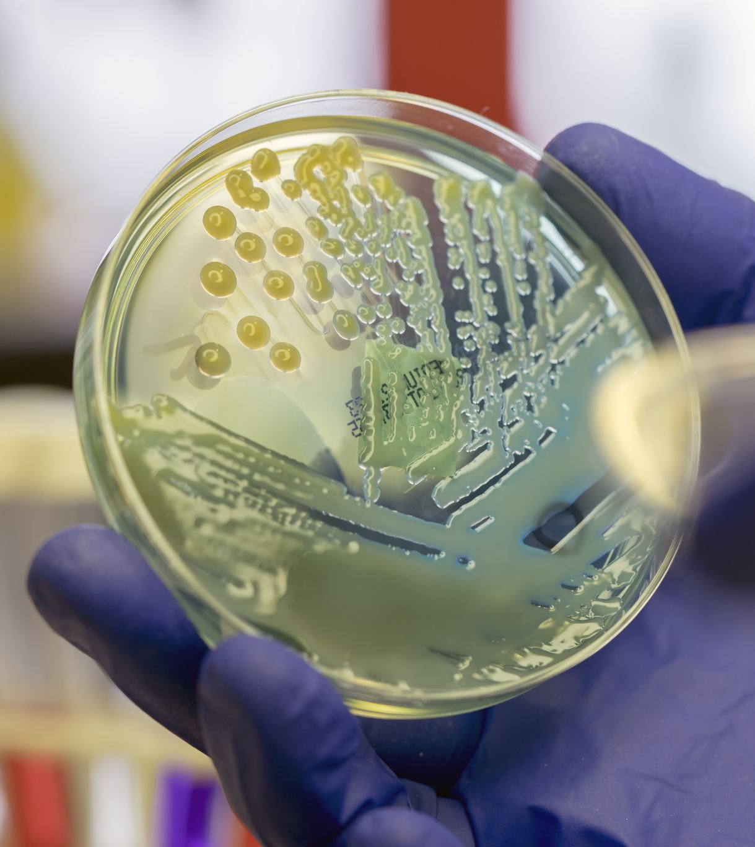
Transmission of Virus
Person to person with minimal or no symptoms.
Droplet contact: Coughing or sneezing
Entry points: Eyes, nose and mouth
Community and Faith-Based Organizations. (n.d.). Retrieved March 2020, from https://www.cdc.gov/coronavirus/2019-ncov/community/organizations/index.html

Slide 11
Protecting Yourself & Others
There is no proven treatment for coronavirus
Stay at home, notify your personal care physician
Self quarantine for 14 days
Drink plenty fluids
Monitor symptoms
Wear masks around others in the home including pets
HAND WASHING, MASKS, SOCIAL DISTANCING IS THE KEY!!
Community and Faith-Based Organizations. (n.d.). Retrieved March 2020, from https://www.cdc.gov/coronavirus/2019-ncov/community/organizations/index.html

Slide 12
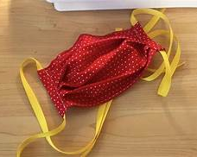
FACE COVERINGS and SOCIAL DISTANCING
All clergy, staff and members MUST wear a mask : fabric masks washed daily or hospital/surgical mask it must be changed daily. If no mask present, the church will provide one.
Limit the size of your groups.
6 feet apart in either direction: Front–back and side to side.
Cover cough or sneezing with a tissue or into elbow.
No hand shaking or hugging for now.
Community and Faith-Based Organizations. (n.d.). Retrieved March 2020, from https://www.cdc.gov/coronavirus/2019-ncov/community/organizations/index.html

Slide 13
HANDWASHING: CLERGY, STAFF and MEMBERS
Wash hands 20 seconds with soap and water.
If soap and water not available: Use hand sanitizer located in designated areas.
Make sure when using the soap or the sanitizer that your hands feel dry.
AVOID TOUCHING EYES, NOSE AND MOUTH WITH UNWASHED HANDS
Community and Faith-Based Organizations. (n.d.). Retrieved March 2020, from https://www.cdc.gov/coronavirus/2019-ncov/community/organizations/index.html

Slide 14
Proper Handwashing Technique ( To assess click link below)
https://youtu.be/zCx50OYOiXk
Proper Handwashing Procedures. Video file. Accessed March 2020. Retrieved from HTTPS://YOUTU.BE/ZCX50OYOIXK

Slide 15
Proper Placing and Removal of Mask ( To assess click link below)
https://youtu.be/vuO_iaZH8ZQ
Proper Facemask wearing. Video file. Accessed March 2020. Retrieved from https://youtu.be/vuO_iaZH8ZQ

Slide 16
Health Monitoring and Screening
Check your temperature daily: No members will be allowed to enter with a fever greater than 99-degree Fahrenheit or above.
1
Your temperature will be check before entry to the sanctuary or social hall.
2
Don’t take your temperature within 30 minutes of exercise or taking medication such as Tylenol.
3
Watch also for shortness of breath, loss of taste, and persistent wet or dry cough, sore throat and diarrhea.
4
Contact your medical provider and or go to an emergency room especially for shortness of breath.
5
Community and Faith-Based Organizations. (n.d.). Retrieved March 2020, from https://www.cdc.gov/coronavirus/2019-ncov/community/organizations/index.html

Slide 17
Testing sites
Dade County
Drive thru
Marlins Park
South Dade Government Center
Hard Rock Stadium
Amelia Earhart Park
Miami Beach Convention Center
Walk Up Testing
1. North Miami: Holy Family Catholic Church
2. Opa-locka: Sherbondy Park
Broward County
Broward Health
Central Broward Park
Cleveland Clinic
Festival Marketplace
Mitchell Moore Park ( Walk-up)
National Guard and Memorial Health Systems
Urban League of Broward County (Walk-up)
These are only a few: Please refer to www.miamidade.org and www.broward.org. For a complete list of tests.

Slide 18
CLEANING and DISINFECTING
Daily: Tables, desks, phones, keyboards, toilets, faucets and sinks.
Dirty surfaces: Use detergent or soap and water prior to disinfecting.
Use Household disinfectant to clean area after simple washing has been done.
Community and Faith-Based Organizations. (n.d.). Retrieved March 2020, from https://www.cdc.gov/coronavirus/2019-ncov/community/organizations/index.html

Slide 19
Emergency Plan: (Mitigation) For COVID 19
Team on duty masks/ gloves
Remove ill person immediately to designated area( Usher’s Room for members/guests and count room for office staff).
Retake temperature and Document.
Actions as indicated by assessment.
Advise to 14-day self quarantine and notify primary care physician.
Follow-up wellness check on the ill individual(s) by the team.
Close off area used by the sick person and clean/ disinfect the area.

Slide 20
Liturgy and Worship training Session
William (Bill) Anderson, Master of Ceremony
Kathy Wyche Latimore, Lay Eucharist Minister
Cheryl Collier, Lector/Server
Cynthia Burroughs, Lector
The Reverend Roberta (Bobbie) Knowles+
Rector

Slide 21
How will we move forward when our sanctuary re-opens?
At this time there will be no children on the altar as servers.
There will be no singing during the service, except maybe Rev. Bell as he does now or a soloist. If Rev. Bell or a soloist sings then we will not be able to use the pews in the choir stall at all.
The congregation will stand when the organist begins the music for the processional In. The priest and servers will then enter through the doors nearest to the altar and after the service they will leave through the same doors, keeping a six feet distance throughout the service.
The priest and all servers will wear their mask during the service, except when the lectors are reading and when the priest is speaking.

Slide 22
How will we move forward when our sanctuary re-opens? (cont.)
Since we are planning to continue with videotaping the service, the two front pews on either side of the center row will have to remain vacant to give the videographer the space needed.
The LEM’s will be kept at a minimum, using the same persons who presently attend the Sunday services because they are familiar with the way the service is presently done.
The priest will continue to speak from the altar using the microphone on the altar that includes celebrating and preaching.
The lectors will alternate between the two lecterns, giving sufficient time to clean the lectern and microphone before they are used again.

Slide 23
How will we move forward when our sanctuary re-opens? (cont.)
During the singing of the offertory hymn the counters will collect the money from the boxes and bring it to the altar where the priest will bless it. There will be no offering collected from parishioners at that time. If parishioners were not able to put their offering in the box when they arrived at church, they will be able to place their offering in the box as they leave, it will then be removed later and placed in the lock box in the office and counted the following week.

Slide 24
The Sacraments
A visible and tangible signs of an invisible but real grace. Through water, oil, bread and wine, we encounter the grace of God afresh, and that’s why the Sacrament is important to us as Episcopalians. Baptism and Eucharist are known as the sacraments of the gospel, they both have their origins in the life and ministry of Jesus.

Slide 25
The Eucharist
We are sacramental people and many parishioners are anxious to return to the sanctuary for the Bread & Wine, but during this time the Eucharist will not be given, the priest is the only person who will continue to consume the Bread & Wine. During the singing of the Communion Hymn the priest will stand at the altar and go in front of the four sections of the pews, parishioners sitting in that section will stand and the priest will bless them as a symbolic sign of receiving the Bread & Wine.

Slide 26
Holy baptism
On page 298 of the Book of Common Prayer, Baptism is described as “full initiation by water and the Holy Spirit into Christ’s Body the Church.” After Jesus’ Baptism a voice came from heaven saying, “This is my beloved Son, in whom I am well pleased” (Luke 3:16, 22). For Jesus this marked the beginning of his public ministry. Having said all of that, the church of the Incarnation will baptize if babies, children or adults come forward, but in the case of babies, the priest will not hold the baby or infant, instead the parents will be expected to hold their child/children and the priest will pour water over the head of the baby or infant and bless them.

Slide 27
Closing of service
The priest will give the announcements until further notice.
The Senior Warden will speak to the congregation when it is necessary.
Following the dismissal, the altar servers and priest will leave by the same doors they came in and the congregation will leave from the designated doors that are clearly marked.

Slide 28
prayer
Heavenly Father, in you we live and move and have our being: We humbly pray you so to guide and govern us by your Holy Spirit, that in all the cares and occupations of our life we may not forget you, but may remember that we are ever walking in your sight; through Jesus Christ our Lord. Amen.

Slide 29
Now, let’s work it out for our sacred safety
Look and think about the steps you perform for each component of the service. Visualize.
Incorporate a model, where if a member of the clergy unknowingly had the Corona Virus, that includes precautions that might prevent exposure to other members of the Clergy or Guild members or Mr. Roberts.
Wear Masks?
Wash hands or use hand sanitizer before and after every component of the service? Microphones, touch areas, ringing bells, Wine, Water vessels?

Slide 30
Now, let’s work it out for our sacred safety (cont.)
How do you ensure that after each step of the service, that you are consciously, intentionally reducing your exposure to the Virus?
Is it appropriate to also wear gloves with masks during the removal of Altar articles after the service?
What other safety protocols should be considered to mitigate the spread of COVID-19 to other guild members or Clergy?

Slide 31
Now Let’s Practice

Slide 32
Question and Answer

