Slide 1
Church of the Incarnation CHURCH INFORMATIONAL SESSIONs Health Teams/Greeters-1:00 P.M. Ushers-2:00 P.M. AUGUST 11, 2020
In Sacred Safety
Reverend Roberta Knowles, RECTOR+

Slide 3
Agenda
Welcome
Mission and Purpose
Five Saves Lives!
Medical Health Re-Entry Protocols
(Conducted by Reverend Bell, Cynthia Anderson and Mildred Byrd)
Informational Group Session- USHERS
Let’s Practice!
Q&A

Slide 4
Our mission:
“On Being Faithful provides each of our congregations, schools, and special ministries clear guidance and direction for how we in this diocese may begin to move forward as a witness to the forming of new habits and practices by which to live courageously and faithfully into the new season that is now unfolding before us.”
Excerpt from On Being Faithful Guidelines for a Shared Discernment on the Way Ahead in this Season of COVID-19- South Florida Diocese, Bishop Peter Eaton++

Slide 5
Staying on track Our coi-crpc task & purpose
The Church of the Incarnation Church Re-entry Planning Committee Purpose:
Our Task: When the time is right (health conditions being mitigated according to health officials) and we have the plan of action, training, essential equipment and supplies -we will have a document to request that we re-enter our beloved Church of the Incarnation. This document will be reviewed by the parish council, vestry, rector, deanery and prayerfully approved by the bishop’s office.
We seek to use a Powerpoint and a Checklist Approach to Educate, Inform and Train our groups and general membership.
Generate a Request Letter to the Bishop to re-open with attached checklists, schedules, evidence of completed training, information, procedures and protocols.

Slide 6
Comfort our membership and guests. Our church is committed to engage in Sacred Safety practices.
Inform and encourage our members to embrace the mandatory changes that will be implemented.
We will wear masks, conduct temperature checks, maintain social distancing, perform contact tracing, collect waivers, hand wash and use hand sanitizer.
Request that all members agree to leave the premises as soon as the service is over.
Usher-directed, we will use the designated doorways to discourage social gathering.
Expect that our members will adhere to the signage and CDC-approved directions provided.
We will follow guidelines on where and how to enter the parking areas/premises/worship areas/restrooms.
Faithfully and safely keep our members informed and mobilized.
We will continue to chart a path to grow, enhance and fund our Church’s mission: Evangelism.
Decisions by the Rector, Vestry and COI-CRPC will be based upon the health and safety of our parishioners as the first priority. This five-point plan will be monitored/maintained by the Church of the Incarnation–Church Re-entry Planning Committee (COI-CRPC) Vestry and Rector.
The FIVE–POINT Plan
“FIVE SAVES LIVES!”
The Rector, Vestry and Church of the Incarnation, Church Re-entry Planning Committee will implement Five Saves Lives! (Our Five Point Plan) to:

Slide 7
Church of the COVID 19 Reopening Health Team Training Session
Cynthia Anderson, RN,ADN
Reverend James Bell, RN,MSN
Mildred Byrd, RN,BSN

Slide 8
Brief Overview of Coronavirus/COVID 19
DEFINITION
An acute respiratory syndrome (group of symptoms occurring together) caused by the newly discovered coronavirus. It’s a virus within the corona.
SYMPTOMS
May appear 1-14 days after exposure
Can affect persons differently
May include: Fever greater than 99.0 F
Chills ,body aches, headache and or persistent dry cough
Shortness breath, running nose
Sudden loss of taste or smell
Sudden confusion and inability to stay awake
Chest pain or discomfort
SEEK EMERGENCY MEDICAL CARE IMMEDIATELY
Community and Faith-Based Organizations. (n.d.). Retrieved March 2020, from https://www.cdc.gov/coronavirus/2019-ncov/community/organizations/index.html

Slide 9
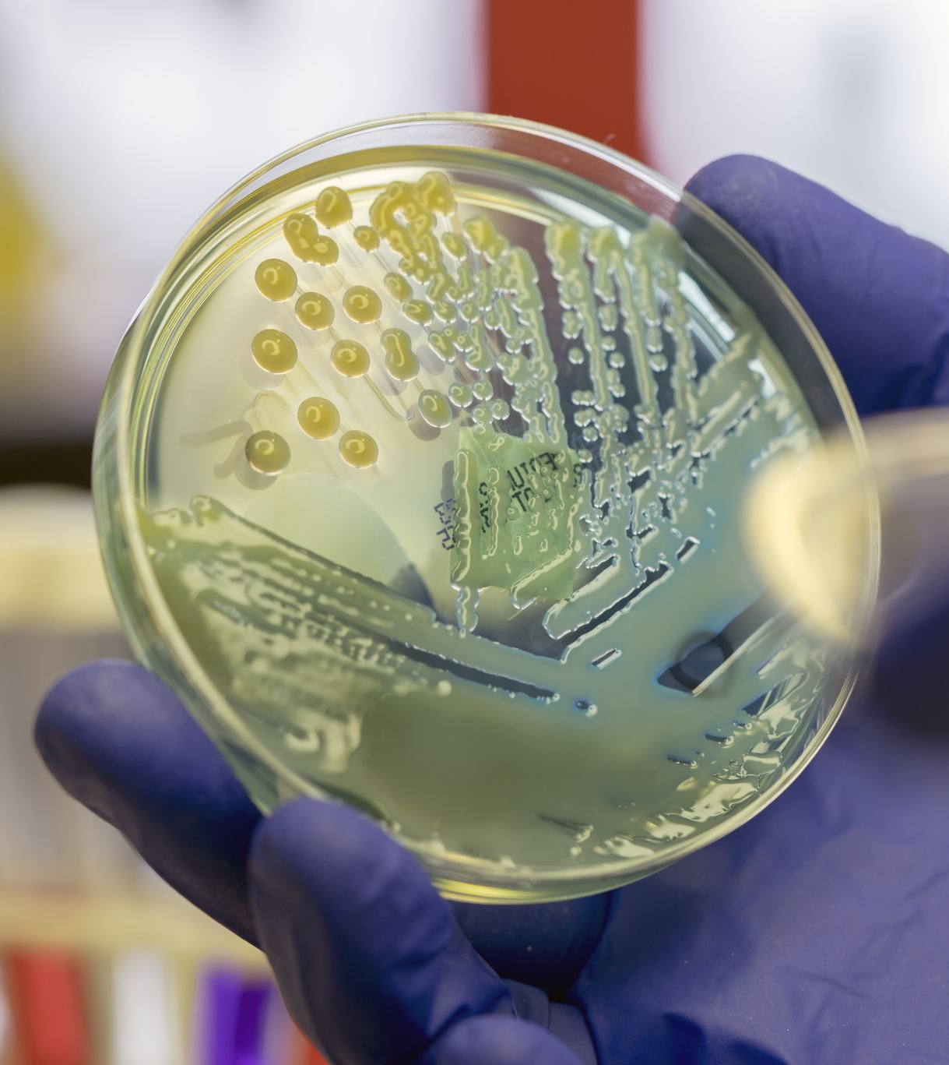
Transmission of Virus
Person to person with minimal or no symptoms.
Droplet contact: Coughing or sneezing
Entry points: Eyes, nose and mouth
Community and Faith-Based Organizations. (n.d.). Retrieved March 2020, from https://www.cdc.gov/coronavirus/2019-ncov/community/organizations/index.html

Slide 10
Protecting Yourself & Others
There is no proven treatment for coronavirus
Stay at home, notify your personal care physician
Self quarantine for 14 days
Drink plenty fluids
Monitor symptoms
Wear masks around others in the home including pets
HAND WASHING, MASKS, SOCIAL DISTANCING IS THE KEY!!
Community and Faith-Based Organizations. (n.d.). Retrieved March 2020, from https://www.cdc.gov/coronavirus/2019-ncov/community/organizations/index.html

Slide 11
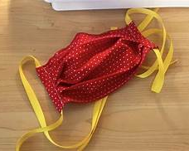
FACE COVERINGS and SOCIAL DISTANCING
All clergy, staff and members MUST wear a mask : fabric masks washed daily or hospital/surgical mask it must be changed daily. If no mask present, the church will provide one.
Limit the size of your groups.
6 feet apart in either direction: Front–back and side to side.
Cover cough or sneezing with a tissue or into elbow.
No hand shaking or hugging for now.
Community and Faith-Based Organizations. (n.d.). Retrieved March 2020, from https://www.cdc.gov/coronavirus/2019-ncov/community/organizations/index.html

Slide 12
HANDWASHING: CLERGY, STAFF and MEMBERS
Wash hands 20 seconds with soap and water.
If soap and water not available: Use hand sanitizer located in designated areas.
Make sure when using the soap or the sanitizer that your hands feel dry.
AVOID TOUCHING EYES, NOSE AND MOUTH WITH UNWASHED HANDS
Community and Faith-Based Organizations. (n.d.). Retrieved March 2020, from https://www.cdc.gov/coronavirus/2019-ncov/community/organizations/index.html

Slide 13
Proper Handwashing Technique ( To assess click link below)
https://youtu.be/zCx50OYOiXk
Proper Handwashing Procedures. Video file. Accessed March 2020. Retrieved from HTTPS://YOUTU.BE/ZCX50OYOIXK

Slide 14
Proper Placing and Removal of Mask ( To assess click link below)
https://youtu.be/vuO_iaZH8ZQ
Proper Facemask wearing. Video file. Accessed March 2020. Retrieved from https://youtu.be/vuO_iaZH8ZQ

Slide 15
Health Monitoring and Screening
Check your temperature daily: No members will be allowed to enter with a fever greater than 99-degree Fahrenheit or above.
1
Your temperature will be check before entry to the sanctuary or social hall.
2
Don’t take your temperature within 30 minutes of exercise or taking medication such as Tylenol.
3
Watch also for shortness of breath, loss of taste, and persistent wet or dry cough, sore throat and diarrhea.
4
Contact your medical provider and or go to an emergency room especially for shortness of breath.
5
Community and Faith-Based Organizations. (n.d.). Retrieved March 2020, from https://www.cdc.gov/coronavirus/2019-ncov/community/organizations/index.html

Slide 16
Testing sites
Dade County
Drive thru
Marlins Park
South Dade Government Center
Hard Rock Stadium
Amelia Earhart Park
Miami Beach Convention Center
Walk Up Testing
1. North Miami: Holy Family Catholic Church
2. Opa-locka: Sherbondy Park
Broward County
Broward Health
Central Broward Park
Cleveland Clinic
Festival Marketplace
Mitchell Moore Park ( Walk-up)
National Guard and Memorial Health Systems
Urban League of Broward County (Walk-up)
These are only a few: Please refer to www.miamidade.org and www.broward.org. For a complete list of tests.

Slide 17
CLEANING and DISINFECTING
Daily: Tables, desks, phones, keyboards, toilets, faucets and sinks.
Dirty surfaces: Use detergent or soap and water prior to disinfecting.
Use Household disinfectant to clean area after simple washing has been done.
Community and Faith-Based Organizations. (n.d.). Retrieved March 2020, from https://www.cdc.gov/coronavirus/2019-ncov/community/organizations/index.html

Slide 18
Responsibility Steps for Greeters and Health Team Volunteers
Greeters must be in place 45 minutes before service start time
All greeters must wash hands, wear mask while doing their assigned duties. ( if taking temperatures, put on gloves).
ENSURE MEMBERS/ GUEST HANDS SANITIZE BEFORE TEMPERATURE TAKEN
Assist the health team in during temperature check/ recordings and a note if indicated, electronically.
Extending a warm ” welcome”, volunteers will open the entrance doors so to allow members to avoid all physical contact with door handles.
Ushers will help direct the flow of members/guests through the entrances and hallways in order to limit time spent within 6 feet of others. Same protocol for exiting church.
Offerings will be collected via the offering box located in church entrance.
Greeters

Slide 19
Responsibility Steps for Greeters and Health Team Volunteers
Health team members must be in place 45 minutes before service start time.
Health team members must wash hands before putting on masks and gloves before taking temperatures.
ENSURE MEMBERS/ GUEST HANDS SANITIZE BEFORE TEMPERATURE TAKEN
Gather the material needed: touchless thermometers. Check/ recordings and a note if indicated, electronically.
Direct the member/guest to an usher for directions into the worship center.
Be ready to assist with any member that suddenly becomes ill and follow the emergency plan.
Be prepared to escalate some medical emergencies to emergency medical services by calling 911.
Health Team

Slide 20
REcap
Two stations, two-person touchless temperature ( acceptable ranges: 96.0 Fahrenheit to 99.0) taken with gloves.
Two temperatures recorders: two persons on the outside assisting the seniors/disabled will be brought to front of the line.
Entry into the worship service by an usher ONLY.
NO CHANGING OF SEATING PLEASE!!!
NO SOCIAL GATHERING!!!
Team Rotation scheduled each Sunday ( 6 persons).
Team/members arrive 45 minutes prior to start of worship service.
Social distancing 6-feet outside/inside.
One-way entrance
Masks present
Hand sanitizing

Slide 21
Responsibility Steps for Greeters and Health Team Volunteers
This is the how to communicate to member/ Staff with a temperature:
“Your temperature is elevated, let me refer you to Cynthia/Mildred out of an abundance of caution. We ask that you NOT enter the church at this time. Please continue to participate in the live stream worship service. Consult your primary care physician, as soon as possible. Thank you.”

Slide 22
Emergency Plan: (Mitigation) For COVID 19
Team on duty masks/ gloves
Remove ill person immediately to designated area( Usher’s Room for members/guests and count room for office staff).
Retake temperature and Document.
Actions as indicated by assessment.
Advise to 14-day self quarantine and notify primary care physician.
Follow-up wellness check on the ill individual(s) by the team.
Close off area used by the sick person and clean/ disinfect the area.

Slide 23
The Ushers Main Responsibility
Ushers are requested to arrive at least 45 minutes prior to the service.
Enforce social distancing protocols throughout the church; before, during, and after the service.
Communicate in a calm and patient manner, provide calm and patient directions at all time.
Members may be nervous and must be informed of the new protocols.
Before seating, please refer members to the offertory boxes before the service begins.
Seat individuals and families while maintaining a social distancing.

Slide 24
BeFore ParishionersEnter the Church
Establish monitoring positions, not only in the narthex and sanctuary, but at the main parking lot (for only prior to the start of the service).
Ensure parishioners are lining up at the designated entrances-Location: The two outer doors of the front main entrance.
Mr. Parker/Mr. Roberts will advise the security on the expectations of their role: They must wear masks, remain socially distant also.

Slide 25
During Service
Place mobile signage and mobile touchless hand sanitizers, at the designated socially distant areas each Sunday before the service. Please ensure that the mobile stations are stored back in secure storage at the end of each service.
IMPORTANT: THE OFFICE PARKING LOT IS CLOSED DURING THE SERVICE. PARKING CONES OR ROPE SHOULD BE USED TO PREVENT THE USE OF THE OFFICE PARKING LOT DURING SUNDAY SERVICE. THE RECTOR AND CLERGY WILL PARK IN THE MAIN PARKING LOT ON SUNDAY.

Slide 26
During Service
Due to CDC protocols and the limited number of volunteer sanitation teams, only the sanctuary, hallway, restrooms are accessible by all parishioners.
The count room and usher room are designated as emergency outbreak areas.
All other areas such as the Parish Hall, Kitchen, Church office, Rector’s office are not accessible at this time.
The Rector’s office and the Church Office will not be accessible by parishioners on Sunday only.

Slide 27
During Service
Ushers guide parishioners to the offertory boxes and socially distant seating. Parishioners are asked to remain where seated to ensure social distancing requirements.
Ushers are fully aware of the changes in the actions performed during the service and have read the updated service bulletin to predict the needs of clergy and members.
Only health teams, ushers may remain in the narthex during service. All other members must sit in the sanctuary, even during the sermon.
The priest has approved entry into the Sanctuary even during the Sermon, but everyone must remain still during the reading of the Gospel.

Slide 28
End Of Service
At the end of the service, encourage members to remain seated until the clergy exit the Sanctuary.
Ensure parishioners remain seated until the ushers dismiss them in an organized manner- starting dismissal from the back to front-at the designated exits.
Location: The two inner doors of the front main entrance.

Slide 29
Now Let’s Practice

Slide 30
Question and Answer

