Slide 1
Church of the Incarnation CHURCH INFORMATIONAL SESSIONs Altar guild AUGUST , 2020
In Sacred Safety
Reverend Roberta Knowles, RECTOR+

Slide 3
Agenda
Welcome
Mission and Purpose
Five Saves Lives!
Medical Health Re-Entry Protocols
(Conducted by Reverend Bell, Cynthia Anderson and Mildred Byrd)
Informational Group Session-ALTAR GUILD
Let’s Practice!
Q&A

Slide 4
Our mission:
“On Being Faithful provides each of our congregations, schools, and special ministries clear guidance and direction for how we in this diocese may begin to move forward as a witness to the forming of new habits and practices by which to live courageously and faithfully into the new season that is now unfolding before us.”
Excerpt from On Being Faithful Guidelines for a Shared Discernment on the Way Ahead in this Season of COVID-19- South Florida Diocese, Bishop Peter Eaton++

Slide 5
Staying on track Our coi-crpc task & purpose
The Church of the Incarnation Church Re-entry Planning Committee Purpose:
Our Task: When the time is right (health conditions being mitigated according to health officials) and we have the plan of action, training, essential equipment and supplies -we will have a document to request that we re-enter our beloved Church of the Incarnation. This document will be reviewed by the parish council, vestry, rector, deanery and prayerfully approved by the bishop’s office.
We seek to use a Powerpoint and a Checklist Approach to Educate, Inform and Train our groups and general membership.
Generate a Request Letter to the Bishop to re-open with attached checklists, schedules, evidence of completed training, information, procedures and protocols.

Slide 6
Comfort our membership and guests. Our church is committed to engage in Sacred Safety practices.
Inform and encourage our members to embrace the mandatory changes that will be implemented.
We will wear masks, conduct temperature checks, maintain social distancing, perform contact tracing, collect waivers, hand wash and use hand sanitizer.
Request that all members agree to leave the premises as soon as the service is over.
Usher-directed, we will use the designated doorways to discourage social gathering.
Expect that our members will adhere to the signage and CDC-approved directions provided.
We will follow guidelines on where and how to enter the parking areas/premises/worship areas/restrooms.
Faithfully and safely keep our members informed and mobilized.
We will continue to chart a path to grow, enhance and fund our Church’s mission: Evangelism.
Decisions by the Rector, Vestry and COI-CRPC will be based upon the health and safety of our parishioners as the first priority. This five-point plan will be monitored/maintained by the Church of the Incarnation–Church Re-entry Planning Committee (COI-CRPC) Vestry and Rector.
The FIVE–POINT Plan
“FIVE SAVES LIVES!”
The Rector, Vestry and Church of the Incarnation, Church Re-entry Planning Committee will implement Five Saves Lives! (Our Five Point Plan) to:

Slide 7
Church of the COVID 19 Reopening Health Team Training Session
Cynthia Anderson, RN,ADN
Reverend James Bell, RN,MSN
Mildred Byrd, RN,BSN

Slide 8
Brief Overview of Coronavirus/COVID 19
DEFINITION
An acute respiratory syndrome (group of symptoms occurring together) caused by the newly discovered coronavirus. It’s a virus within the corona.
SYMPTOMS
May appear 1-14 days after exposure
Can affect persons differently
May include: Fever greater than 99.0 F
Chills ,body aches, headache and or persistent dry cough
Shortness breath, running nose
Sudden loss of taste or smell
Sudden confusion and inability to stay awake
Chest pain or discomfort
SEEK EMERGENCY MEDICAL CARE IMMEDIATELY
Community and Faith-Based Organizations. (n.d.). Retrieved March 2020, from https://www.cdc.gov/coronavirus/2019-ncov/community/organizations/index.html

Slide 9
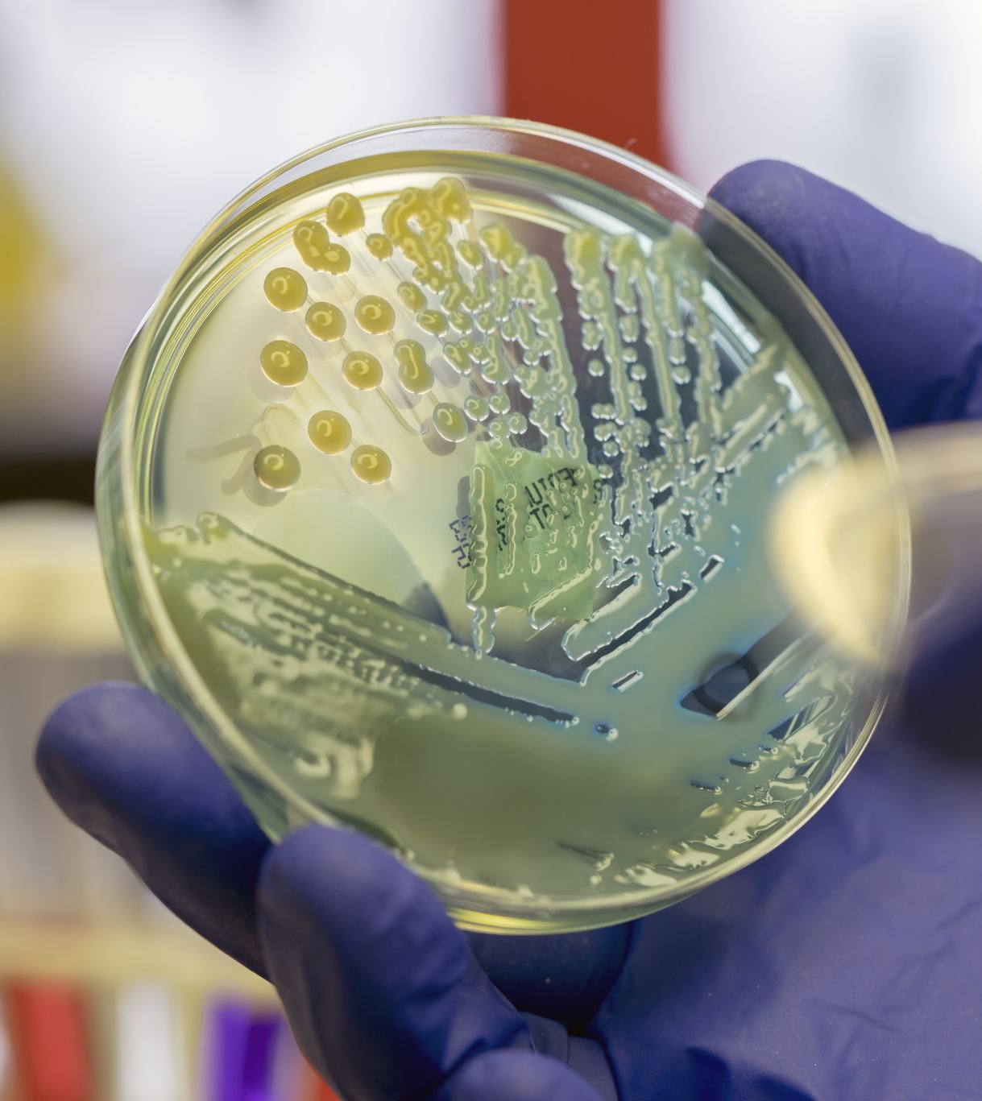
Transmission of Virus
Person to person with minimal or no symptoms.
Droplet contact: Coughing or sneezing
Entry points: Eyes, nose and mouth
Community and Faith-Based Organizations. (n.d.). Retrieved March 2020, from https://www.cdc.gov/coronavirus/2019-ncov/community/organizations/index.html

Slide 10
Protecting yourself & Others
There is no proven treatment for coronavirus
Stay at home, notify your personal care physician
Self quarantine for 14 days
Drink plenty fluids
Monitor symptoms
Wear masks around others in the home including pets
HAND WASHING, MASKS, SOCIAL DISTANCING IS THE KEY!!
Community and Faith-Based Organizations. (n.d.). Retrieved March 2020, from https://www.cdc.gov/coronavirus/2019-ncov/community/organizations/index.html

Slide 11
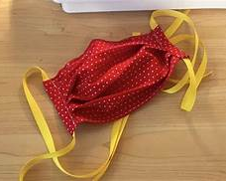
FACE COVERINGS and SOCIAL DISTANCING
All clergy, staff and members MUST wear a mask : fabric masks washed daily or hospital/surgical mask it must be changed daily. If no mask present, the church will provide one.
Limit the size of your groups.
6 feet apart in either direction: Front–back and side to side.
Cover cough or sneezing with a tissue or into elbow.
No hand shaking or hugging for now.
Community and Faith-Based Organizations. (n.d.). Retrieved March 2020, from https://www.cdc.gov/coronavirus/2019-ncov/community/organizations/index.html

Slide 12
HANDWASHING: CLERGY, STAFF and MEMBERS
Wash hands 20 seconds with soap and water.
If Soap and water not available: Use hand sanitizer located in designated areas.
Make sure when using the soap or the sanitizer that your hands feel dry.
AVOID TOUCHING EYES, NOSE AND MOUTH WITH UNWASHED HANDS
Community and Faith-Based Organizations. (n.d.). Retrieved March 2020, from https://www.cdc.gov/coronavirus/2019-ncov/community/organizations/index.html

Slide 13
Proper Handwashing Technique ( To assess click link below)
https://youtu.be/zCx50OYOiXk
Proper Handwashing Procedures. Video file. Accessed March 2020. Retrieved from HTTPS://YOUTU.BE/ZCX50OYOIXK

Slide 14
Proper Placing and Removal of Mask ( To assess click link below)
https://youtu.be/vuO_iaZH8ZQ
Proper Facemask wearing. Video file. Accessed March 2020. Retrieved from https://youtu.be/vuO_iaZH8ZQ

Slide 15
Health Monitoring and Screening
Check your temperature daily: No members will be allowed to enter with a fever greater than 99-degree Fahrenheit or above.
1
Your temperature will be check before entry to the sanctuary or social hall.
2
Don’t take your temperature within 30 minutes of exercise or taking medication such as Tylenol.
3
Watch also for shortness of breath, loss of taste, and persistent wet or dry cough, sore throat and diarrhea.
4
Contact your medical provider and or go to an emergency room especially for shortness of breath.
5
Community and Faith-Based Organizations. (n.d.). Retrieved March 2020, from https://www.cdc.gov/coronavirus/2019-ncov/community/organizations/index.html

Slide 16
Testing sites
Dade County
Drive thru
Marlins Park
South Dade Government Center
Hard Rock Stadium
Amelia Earhart Park
Miami Beach Convention Center
Walk Up Testing
1. North Miami: Holy Family Catholic Church
2. Opa-locka: Sherbondy Park
Broward County
Broward Health
Central Broward Park
Cleveland Clinic
Festival Marketplace
Mitchell Moore Park ( Walk-up)
National Guard and Memorial Health Systems
Urban League of Broward County (Walk-up)
These are only a few: Please refer to www.miamidade.org and www.broward.org. For a complete list of tests.

Slide 17
CLEANING and DISINFECTING
Daily: Tables, desks, phones, keyboards, toilets, faucets and sinks.
Dirty surfaces: Use detergent or soap and water prior to disinfecting.
Use Household disinfectant to clean area after simple washing has been done.
Community and Faith-Based Organizations. (n.d.). Retrieved March 2020, from https://www.cdc.gov/coronavirus/2019-ncov/community/organizations/index.html

Slide 18
Emergency Plan: (Mitigation) For COVID 19
Team on duty masks/ gloves
Remove ill person immediately to designated area( Usher’s Room for members/guests and count room for office staff).
Retake temperature and Document.
Actions as indicated by assessment.
Advise to 14-day self quarantine and notify primary care physician.
Follow-up wellness check on the ill individual(s) by the team.
Close off area used by the sick person and clean/ disinfect the area.

Slide 19
The ALTAR GUILD’s Main Responsibility
The Duties of the Altar Guild is to prepare all things necessary for the Celebration of the Eucharist.

Slide 20
Preparing the vessels for holy communion
Cleaning the Chalice, Ciborium, and Cruets with boiling water @ 150 degrees with ammonia for sterilization for ten minutes.
The Chalice is placed with a purificator on top followed by the Paten. The Paten is the plate used for the Bread (Priest Host) at Holy Communion.
On the Paten lay the Pall. Over all items, arrange the Veil. Followed by the Burse which carries the Corporal.

Slide 21
Preparing the vessels for holy communion
Ciborium resembles the Chalice except it has a lid and carries the Communion Wafers.
Cruets are used for the Wine Lavabo and Water, Pitcher with Water and Lavabo Towel are placed for the Priest to wash hands before the Eucharist begins.
These items are placed on the Credence Table.

Slide 22
Additional Duties of the altar guild
Polish the Tabernacle and Candles
Polish Baptismal Font and Paschal Candle
Maintain/Polish the Votive candles stand and change candles as needed
Clean the Priest Sacristy and cleaning of the Vestments
Change Fair linen as needed
Change the colors on the Altar as needed for the seasons of the year
Polish the candles holders and change the candles as needed on the Altar
Polish the Acolytes Torches/Crosses
Polish the Incense Boat/Thurible

Slide 23
Sacred Safety
Look and think about the steps you perform for each method of preparation.
Incorporate a model, where if a member of the altar guild unknowingly had the corona virus, that includes precautions that might prevent exposure to other guild members or clergy.
Wear masks?
Wash hands or use hand sanitizer before and after every method of preparation of each vessel for holy communion?

Slide 24
Sacred Safety
How do you ensure that after each service, that you are not exposing yourself to the virus?
Wear gloves and masks during the removal of vessels after the service?
Wear gloves and masks during the cleaning/washing of the Sacramental Table clothes and napkins?
What other safety protocols should be considered to mitigate the spread of COVID-19 to other Guild members or clergy?

Slide 25
Now Let’s Practice

Slide 26
Question and Answer

